Slide 1
Tigers - Artbible
Name:

Slide 2
Project Overview
Ball in hoop arcade/carnival game targeted towards teens and young adults.
Using trick shots to build up the score.
Hand painted textures.
Only Albedo.
Target platform – VR.
Engine – Unity.

Slide 3
Schedule
Task | Software | Milestone
Pre-Production | Powerpoint | 15/06
Blockout | Maya/Unity | 16/06
Modeling Assets | Maya | 24/06
Texturing Assets | Maya | 24/06
Lighting | Unity | 24/06
Polish/Post Production | Unity | 24/06

Slide 4
Folder Structure/Naming Conventions
●_EXPORTS
○Mesh
■SM_meshName.fbx
○Textures
■assetName_BC.tga
■assetName_M.tga
■assetName_R.tga
●Maya
○Modelling
■assetName_i001.ma
●Texturing
■assetName_texture_i001.spp
■assetName_texture_i001.psd

Slide 5
Asset List
Asset | Polycount (Max.) | Designated Material | Texture Size | Tileable Texture | Assigned | Mesh Done | Texture Done
SM_Ball | 50 | M_Machine | 2048 x 2048 | No | Tiana
SM_Hoop | 300 | M_Misc | 1024 x 1024 | No | Jack
SM_Scoreboard | 100 | M_Machine | 2048 x 2048 | No | Mackenzie
SM_Targets (Includes Stand) | 200 | M_Misc | 1024 x 1024 | No | Mika
SM_ArcadeMachine Hoop Guide | 400 | M_Machine | 2048 x 2048 | No | Mika
SM_Wall | 100 | M_Machine | 2048 x 2048 | No | Mackenzie
SM_Floor | 20 | M_Machine | 2048 x 2048 | No | Tiana
SM_Pillar | 100 | M_Misc | 1024 x 1024 | No | Jack
SM_Lightbulb | 50 | M_Misc | 1024 x 1024 | No | Jack
SM_Pole | 50 | M_Misc | 1024 x 1024 | No | Mackenzie
SM_Flags | 20 | M_Misc | 1024 x 1024 | No | Tiana

Slide 6
Moodboard

Slide 7
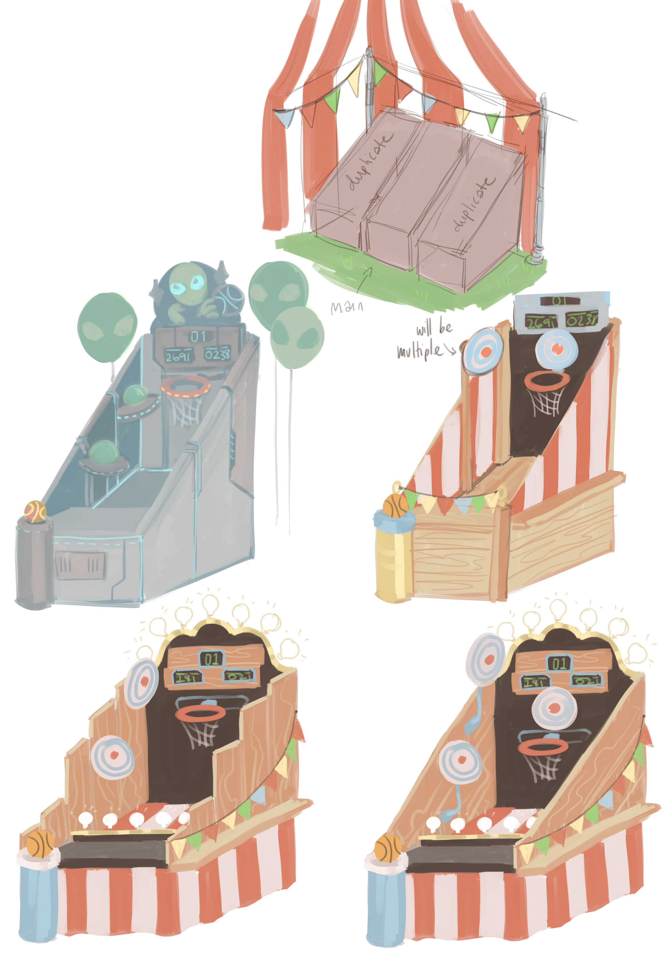
Concept

Slide 8
Art STYLE - mODELING

Slide 9
Art STYLE - texturing

Slide 10
Colour Palette

